Slide 1
SPECIAL PROGRAM FOR UNCERTIFIED PRE-PRIMARY AND PRIMARY SCHOOL TEACHERS

Slide 2
MODULE 1
EDUCATIONAL PSYCHOLOGY

Slide 3
Introduction of participants
Self-Introduction (using a game: throwing the ball)

Slide 4
House keeping rules
Brainstorming the housekeeping rules

Slide 5
Expectations
What do you expect to learn in this module?

Slide 6
Module learning outcomes
By the end of this module, you will be able to:
Explain the concepts of Psychology, Education and Educational psychology.
Explain the various behavioural patterns of children at different stages of development.
Justify the importance of studying personality for a teacher.
Apply the knowledge of social psychology in school context.
Apply key learning and teaching theories in the classroom setting.
Enable teachers to diagnose students’ learning difficulties and offer appropriate solutions.

Slide 7
Module structure
Content (6 units)
Introduction to Educational Psychology,
Human Developmental Psychology,
Personality,
Social Psychology,
Learning Theories and their applications to the teaching and learning process,
Guidance and Counselling.

Slide 8
Structure of each unit
Introductory activity
Unit learning outcomes
Sections ( Each section starts with an activity , Section Content and Application activity)
Conclusion (self-reflection activity, unit summary, end of unit assessment activity).

Slide 9
Relevance of Educational Psychology for teachers
Discuss the relevance of educational psychology for teachers.
(Think-pair-share)

Slide 10
Unit 1: INTRODUCTION TO EDUCATIONAL PSYCHOLOGY
Introductory Activity 1 (Think-pair-share)
You have been trained in secondary school and now, you are teachers in different nursery and primary schools:
Based on your personal experiences as a student and now as a teacher, do you believe that a teacher needs to have complete understanding of his or her students? Why?
What kind of knowledge is required of teachers in order to effectively teach students?

Slide 11
Unit 1 Learning outcomes
Demonstrate an understanding of the concepts of Psychology, Education and Educational Psychology.
Explain the importance of Educational Psychology for a teacher.

Slide 12
Structure of unit 1
Concept of Education
Concepts related to psychology
Importance of psychology in teaching and learning
Concept of Educational Psychology and its importance to a teacher

Slide 13
Section 1.1: Education
Activity 1.1 (Brainstorming and Discussion)
From your own experience, explain how children are educated in our society.

Slide 14
Education (Cont’d)
Education is the process of:
Imparting or acquiring general knowledge,
Developing the power of mental processes (reasoning, judging, imagination, creativity)
With the aim of preparing oneself or others intellectually for mature life.

Slide 15
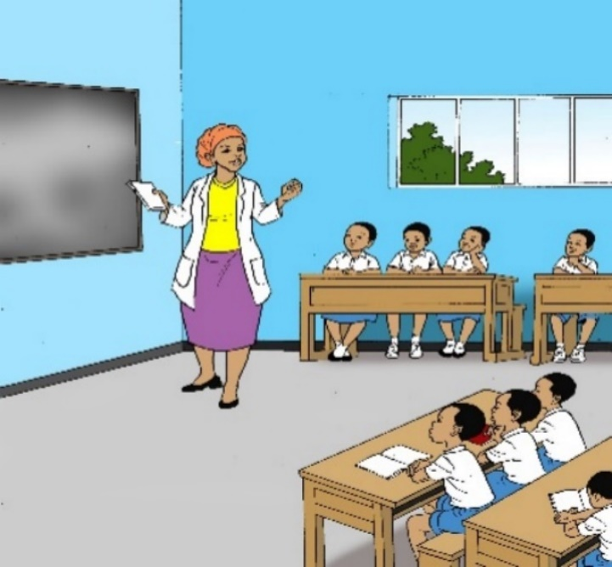

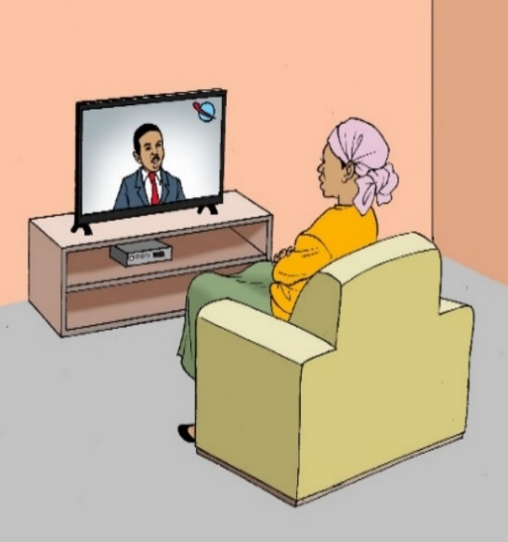

Education (Cont’d): Forms of Education
FormFs of Education Forms of Education
Formal Education
Non-formal Education
Informal Education

Slide 16
Education (Cont’d)
Application Activity 1.1 (Brainstorming)
You have now acquired information about different forms of education, do you think that all those forms of education are relevant to the Rwandan society? Justify your answer.

Slide 17
Section 1.2. Concepts related to Psychology
Activity 1.2 (Group Discussion)
You have been observing learners at your school playing alone or with others, or even in class. Describe the behaviours or attitudes they manifested most.

Slide 18
Concepts related to Psychology (Cont’d)
Those Concepts are:
Psychology,
Human behaviour,
Mental process (memory, emotion, perception, thinking, imagination, reasoning, etc.)
1.2. Concepts related to Psychology

Slide 19
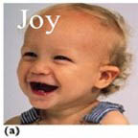
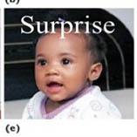
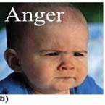




Concepts related to Psychology (Cont’d)
Emotion:
fear,
disgust,
anger,
surprise,
happiness
sadness.

Slide 20
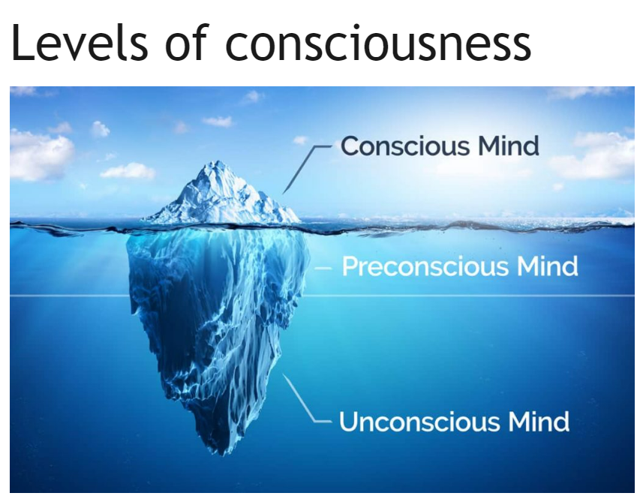
Concepts related to Psychology (Cont’d)
Consciousness-unconsciousness

Slide 21
Concepts related to psychology (Cont’d)
Intelligence
Types of intelligence
Linguistic intelligence involves aptitude with speech and language.
Logical-mathematical intelligence involves the ability to reason abstractly and solve mathematical and logical problems.
Spatial intelligence is used to perceive visual and spatial information and to conceptualize the world in tasks like navigation, painting, etc.

Slide 22
Concept related to Psychology (Cont’d)
Types of intelligence
Musical intelligence refers to the ability to perform and appreciate music.
Bodily-kinesthetic intelligence is the ability to use one’s body or portions of it in various activities, such as dancing, athletics, acting, surgery, etc.
Interpersonal intelligence involves understanding others and acting on that understanding.

Slide 23
Concepts related to Psychology (Cont’d)
Intrapersonal intelligence is the ability to understand oneself.
Naturalist intelligence is the ability to recognise and classify plants, animals, and minerals.
Learning has been defined as a relatively permanent change in behaviour that occurs as the result of prior experience or practice.
Motivation is the internal process that activates, guides, and maintains behaviour over time.

Slide 24
Concepts related to Psychology (Cont’d)
Other concepts related to psychology
Sensation is the stimulation of sensory receptor organs (eyes, ears, nose, tongue, skin, etc.) and the transmission of sensory information to the central nervous system for further processing.
Perception is the interpretation of sensation. Perception is thus the process by which sensations or sensory impressions from sense organs are made meaningful.

Slide 25
Concepts related to Psychology (Cont’d)
Memory is the ability of an individual or a learner to retain or store information acquired and then later retrieve all or some of it for use while forgetting is a process characterized by inability to recall, recognize, and reproduce the learned materials or tasks

Slide 26
Concepts related to Psychology (Cont’d)
Application Activity 1.2 (Individual work)
Some of the behaviours that you observe at school are translated into psychological concepts. Match the statements below with their corresponding terms from the following: psychology, behaviour, mental process, consciousness, subconsciousness, unconsciousness, intelligence.

Slide 27
S/N | Statements | Concepts
1 | The ability to acquire and apply knowledge and skills. | Behaviour
2 | Students are jumping. | b) Psychology
3 | I have completely forgotten the taste of breast milk of my mother. | Consciousness
4 | During the exam, Anna reflected too long on a question and suddenly got the correct answer. | d) Mental process
5 | All of what I am aware of. | Intelligence
6 | At school, students are asked to use creativity, imagination, thinking and reason well to provide good answers. | Sub consciousness
7 | The study of human behaviours and mental processes. | g) Unconsciousness

Slide 28
Section 1.3: Importance of Psychology in Teaching and Learning
ACTIVITY 1.3 (Brainstorming)
As teachers who have just studied concepts related to Psychology, do you think that all teachers must study Psychology? Justify your answer.

Slide 29
Importance of Psychology in Teaching and Learning (cont’d)
To know the student
To select and organize the subject content or learning experiences
To identify tools and techniques of teaching and learning
To provide guidance services
To solve classroom problems

Slide 30
Importance of Psychology in Teaching and Learning (Cont’d)
To know about himself/herself
To build relationships
To improve communication
To build self-confidence
To enrich careers

Slide 31
Importance of Psychology in Teaching and Learning (Cont’d)
Application activity 1.3
Suppose that you are teaching Primary two (P2) class. Describe what you will do during the lesson to motivate your learners, to activate their sensation and perception, to ensure that they are effectively learning, to focus on the three areas of Educational Psychology (knowledge about learners, the learning process, and the learning situation).

Slide 32
Section 1.4: Concept of Educational Psychology and its Importance to a Teacher
Activity 1.4. (Think-Pair-Share)
Scenario:
In a classroom, students are seated in groups around tables in a circle. They are working in 4 groups of 5 members each. A female teacher whose name is MUTUMWINKA is facilitating one group. On the walls of the classroom, there are pictures such as digestive system, urinary system, world map, map of Africa, map of Rwanda, fish, goat, table for the teacher, books, and teacher’s chair.
Tasks:
Describe your own classroom setting when you are teaching.
Based on this scenario above and your own experience as a teacher, compare your own classroom setting with the classroom described in the scenario.
Which one do you think facilitates students’ learning?

Slide 33
Concept of Educational Psychology and its Importance to a Teacher (Cont’d)
Meaning of Educational Psychology and its key related concepts
A branch of Psychology that studies the behavior of the learner in educational settings is called Educational Psychology.
The goal of Educational Psychology is to suggest ways and means of improving the process and products of education.
It also aims to facilitate effective teaching and effective learning because the core business of schools is teaching and learning.

Slide 34
Concept of Educational Psychology and its Importance to a Teacher (Cont’d)
Importance of Educational Psychology to a teacher
This will allow the teacher to:
Design a stimulating classroom context / environment in place,
Know the learner,
Know the learning process,
Know the learning situation.

Slide 35
Concept of Educational Psychology and its Importance to a Teacher (Con’t)
Application Activity 1.4 (Group discussion)
Suppose that you are teaching Primary two (P2) class. Your topic is “My family” in Social Studies subject. Describe what you will do during this lesson to motivate your learners, to activate their sensation and perception, to ensure that they are effectively learning, to focus on the three areas of Educational Psychology (knowledge about learners, the learning process, and the learning situation).

Slide 36
Unit Summary
Meaning of Psychology
Meaning of Intelligence
Types of intelligence
Importance of Psychology for a teacher as it allows him/her to know the learners he/she is teaching and adapt the teaching accordingly.
Importance of Educational Psychology in teaching and learning (Setting a conducive teaching and learning environment).
Importance of motivating learners

Slide 37
DAY 2

Slide 38
Welcoming teacher trainees and recap of day 1

Slide 39
UNIT 2: HUMAN DEVELOPMENTAL PSYCHOLOGY

Slide 40
HUMAN DEVELOPMENTAL PSYCHOLOGY
Introductory activity 2 (Group discussion, presentation and gallery work)
There are many changes that have taken place in your life since you were born until now. Describe some of those changes with the approximate ages on which they took place.

Slide 41
Unit 2 Learning Outcomes
Demonstrate an understanding of concepts related to human development.
Describe the determinants, principles, periods, and domains of human development.
Explain the various behavioural patterns of children at different stages of development.

Slide 42
Unit 2 structure
This unit covers:
Key Concepts Related to Human Developmental Psychology
Determinants of Human Development
Principles of Human Development
Periods of Human Development
Domains of Human Development
Implications of Human Developmental Psychology on Teaching and Learning

Slide 43
Section 2.1: Key Concepts Related to Human Developmental Psychology
Activity 2.1 (Brainstorming)
The following activity is about assessing your prior knowledge of human developmental psychology bearing in mind that life starts from the time of conception and ends at death. Based on your personal observations and experiences; chronologically, outline the periods of human development according to the Rwandan culture and provide their approximate ages.

Slide 44
Key Concepts Related to Human Developmental Psychology (Cont’d)
Human Developmental Psychology is the study of progressive changes in the behavior and abilities of an individual from conception to death
Growth is the quantitative increase in size, length, height, and weight. It involves the multiplication and growth of body cells.

Slide 45
Key Concepts Related to Human Developmental Psychology (cont’d)
Development is an increase of capacity and skill of a person through growth, maturation and learning to adapt to the environment.
Maturation means changes that occur naturally and spontaneously and are to a large extent hereditarily programmed.

Slide 46
Key Concepts Related to Human Developmental Psychology (cont’d)
Application Activity 2.1 (think-pair-share)
Assuming that in your class you have learners, who are over the average size of their classmates which makes them feel uneasy. Briefly explain what you can do to help them learn effectively.

Slide 47
Section 2.2: Determinants of human development
Activity 2.2 (Think-pair-share)
Referring to your everyday experience, explain some factors that have influenced your own development.

Slide 48
Determinants of human development (cont’d)
Heredity (biological inheritance ): the transmission of traits from one generation to the other
Environment:
Physical environment
Social Environment
Family
Peers
School
Mass media

Slide 49
Determinants of human development( Cont’d)
Application activity 2.2 (group discussion)
Learners at school are influenced by peers. Some influences might be negative. As a teacher who has studied factors influencing human development, explain what you will do to minimize negative influence by the peers.

Slide 50
Section 2.3: Principles of human development
Activity 2.3 (Voting card
Below, you are given pairs of body parts of an infant. From each pair, indicate the body part that matures first.
Head and legs
Trunk and hands
Arms and fingers
Neck and trunk
Arms and legs

Slide 51
Principles of human development ( Cont’d)
Development proceeds from the head downwards (cephalocaudal principle)
Development proceeds from the center of the body outwards (proximodistal principle )
Development proceeds from general to specific
Growth and development are continuous processes

Slide 52
Principles of human development( Con’t)
Development depends on maturation and learning
Growth is continuous and gradual
Growth proceeds more rapidly during early years
Development is a product of heredity and environment.

Slide 53
Principles of human development( Cont’d)
Application Activity 2.3 (Working in groups and presentation)
Kwibuka is a teacher in P3 and has excellent learners in his class. He sometimes prepares for them P5-level questions but almost all of them fail. He wonders why they fail yet they are brilliant. Now, as a trainee who has studied Principles of Human Development, how would you help Kwibuka in this situation?

Slide 54
Section 2.4:Periods of Human Development
Activity 2.4 (Think-Pair-Share, Presentation)
Observe different people in your village. Can you differentiate the following categories of people?
A baby and a toddler?
A child and an adolescent?
An old person and an aged person?

Slide 55
Periods of Human Development( Cont’d)
Prenatal period is the time prior to birth, i.e., from conception to birth.
Infancy period from birth to 18 or 24 months: it is a time of extreme dependence on adults.
Early childhood: The period extends from the end of infancy to about 5 or 6 years. The period is called the preschool years.

Slide 56
Periods of Human Development( Cont’d)
Middle and late childhood: This period extends from 6 to 12 years of age. It corresponds to the elementary school years.
Adolescence period: It is a developmental period of transition from childhood to early adulthood that occurs approximately at 11 to 12 years of age and ends at 18 to 21 years of age.

Slide 57
Periods of Human Development (Cont’d)
Adulthood: it includes young adulthood (20-40 years) and middle adulthood (40- 60 years). It is the period in the human lifespan in which full physical and intellectual maturity has been attained.
Old age: may be defined as the stage from age 60 until death. Most people retire from work and no longer have the major responsibility of caring for others.

Slide 58
Periods of Human Development (cont’)
Application Activity 2. 4 (group discussion, brainstorming, question and answer)
With reference to the class level that you teach, what is the approximate age and period of development of your learners?
How does the knowledge about periods of development helps you to effectively teach your learners?

Slide 59
Section 2.5:Domains of Human Development
Activity 2.5 (Group discussions and presentations)
Make groups of three persons and discuss what you think would be the domains of human development.

Slide 60
Domains of Human Development (Cont’d)
Physical development
Increase in height and weight
Reflexes development
Motor development
Cognitive development

Slide 61
Stages of cognitive development as described by Jean Piaget
S/N | Stages | Years | Characteristics
1 | Sensorimotor stage | Birth - 2 years | Infants understand the world through senses and actions. For example, they learn what dogs look like and what petting them feels like.
2 | Preoperational stage | 2-7 years | Toddlers and young children acquire the ability to internally understand and represent the world through language and mental images. They also begin to be able to see the world from other people’s perspectives, not just from their own.
3 | Concrete operational stage | 7-12 years | Children become able to understand the world through logical thinking and categories, not just through intuitive thinking. They understand that events are often influenced by multiple factors, not just one.
4 | Formal operational stage | 12 years and beyond | Adolescent can understand the world through hypothetical thinking and scientific reasoning. This allows them not only to understand politics, ethics, and science fiction, but also to engage in scientific reasoning.

Slide 62
Domains of Human Development (cont’d)
Social development
The pre-attachment phase: 2 - 3 months of age
Focusing on familiar people: 3 - 6 months
Clear-cut attachment: 6 - 12 months.
Formation of reciprocal relationships

Slide 63
Domains of Human Development (cont’d)
Emotional development
By the age of 2-3 years: Children are assertive about what they want and say no to adult requests
By the age of 3-4 years: Children share toys, taking turns with help.
By the age of 4-6 years: Children show some awareness of moral reasoning, such as “fairness”, and good or bad behavior.

Slide 64
Domains of Human Development (cont’d)
Moral Development
Heteronomous morality or the moral realism (5 to 10 years).
Autonomous morality or morality of cooperation (about 10 years and above).

Slide 65
Domains of Human Development (cont’d)
Language development (prelinguistic period and linguistic period)
The prelinguistic period: this period comprises three stages
1. the crying stage from birth,
2. the cooing/fussing stage from 3 months,
3. the babbling/chatting stage from 6 months)

Slide 66
Domains of human development ( Cont’d)
Linguistic period : it comprises 6 periods
First words (12 months),
Holophrase (14-18 months),
Telegraphic speech (18-24 months),
Multiple word sentence (above 2 years),
More complex structure (above 3 years),
Adult like language structures (5 and 6 years and above).

Slide 67
Domains of human development ( Cont’d)
Application Activity 2.5 (brainstorming, group discussion and Think-Pair-Share)
1. Describe the level at which your learners are; regarding the following domains of human development:
Physical & reflexes development
Cognitive & social development
Emotional & moral development
Language development
NB: Provide clear examples.

Slide 68
Section 2.6:Implications of Human Developmental Psychology on Teaching and Learning
Activity 2.6 (Group discussion & Presentation)
As teachers who have just studied Human Developmental Psychology; do you think that all teachers must study Human Developmental Psychology? Justify your answer.

Slide 69
Implications of Human Developmental Psychology on Teaching and Learning ( Con’t)
Knowledge about the students;
Selecting and organizing the subject matter or learning experiences;
Identifying tools and techniques for teaching and learning;
Creating or arranging appropriate learning situations for students;
Providing guidance services to students;
Solving classroom problems; like backwardness, truancy, bullying, and cheating in the classroom situations;

Slide 70
Implications of Human Developmental Psychology on Teaching and Learning
Application activity 2.6 ( Brainstorming)
You have acquired knowledge about human development domains. How can each domain of development be a starting point in preparing your teaching-learning activities?

Slide 71
Summary of the unit
Various stages of human development are prenatal, infancy, early childhood, middle and late childhood, adolescent period, adulthood, and old age.
The major aspects or domains of human development include physical, cognitive, social, emotional, moral, and language domain.
There are individual differences among children with regard to interpersonal and social relationships, intellectual capacity, …
Human developmental psychology impacts well on the teaching and learning process.

Slide 72
DAY 3

Slide 73
WELCOMING THE TEACHER TRAINEES AND RECAP OF THE DAY 2

Slide 74
UNIT 3: PERSONALITY

Slide 75
PERSONALITY
Introductory activity 3 ( Case study)
Ms. Mukamana is a teacher of Religious Studies in P2. She has just introduced her lesson on Ten Commandments of God. In her class, she has 2 children, Moses and Sun who are shy as their parents. The learner Keza always raises her hands to answer even when there is no question asked and her answers are most of the time wrong and unrelated to the topic being studied. Another learner Kanyana likes to walk around the classroom and sits at any seat she finds during the lesson. Another learner, Suzanne likes to tell colleagues to be polite and do what their teacher asks them to do. She is all the times worried about the order in the class.
Reflection question: Why do learners in this class behave differently?

Slide 76
Unit Learning Outcomes
Demonstrate understanding of the concept of personality.
Describe the factors that influence personality.
Describe the structure of personality according to S. Freud.
Explain psychoanalytic and psychosocial theories of personality.
Justify the importance of studying personality for a teacher.

Slide 77
Unit structure
Section 1: Meaning of personality and related concepts
Section 2: Factors that influence personality
Section 3:Theories of personality

Slide 78
Section 3.1: Meaning of personality and related concepts
Activity 3.1 (ball throwing, Questions-Answers) Page 47
Teacher - trainees tell:
Their names,
What and where they studied,
What they do in life,
Their personal status (single, married, separated, divorced, priests, naans, pastors, etc.),
What they like (hobbies),
Their expectations in the future, etc.
After enough trainees have told who they are, the trainer stops the game and asks why they did not say the same things while they are asked the same question: “who are you”?

Slide 79
Meaning of personality and related concepts (Cont’d)
Personality refers to a set of traits or characteristics that make all people who they are.
Character is a usual and constant manner of being, feeling, acting, and reacting of a person in relation to his environment.
Temperament is the way of being, feeling, acting, or reacting of everybody due to his/her morphology and physiology.
Traits are Personality characteristics that last over time and across different situations.

Slide 80
Meaning of personality and related concepts (Cont’d)
Application activity (Brainstorming)
Considering the behaviours of learners in your class; identify some of their personality traits that you have observed on them.
Give a concrete example that shows the uniqueness, identity, and unicity of the identified learners’ personality in “a” above.

Slide 81
Section 3.2: Factors that influence personality
Activity 3.2, page 49 (Think-Pair-Share)
Exchange ideas about factors that can influence personality
Discuss how they do influence personality
Give concrete examples in your respective schools

Slide 82
Factors that influence personality (Cont’d)
Heredity / Biological factors: Being small, tall, short, slim, fat, black or white, thin, muscular, health and strength, having hair color, the height, weight, physical defects, etc. affect our personality.
Psychological factors such as cognition (what we know), emotional, self-disclosure, complexes (inferiority or superiority), aspiration, achievements, goal setting, mental conflicts, wishes, and thought patterns determine individual’s personality.
Environmental factors such as physical, social, family, cultural, school, and electronic and mass media influence our personality.

Slide 83
Factors that influence personality (Cont’d)
Application activity 3.2 (Group discussions &Presentation)
In pairs, with concrete examples, tell your partner how your personality has been shaped by heredity, then by environment.

Slide 84
Section 3.3: Theories of personality
Activity 3.3 (Brainstorming, Question-Answers)
The trainer asks participants to stand up. They close their eyes as if they are praying. They think of their past experiences starting with the breast milk they enjoyed when they were infants. They try to remember all their experiences during infancy, childhood, and adolescence. They open their eyes and share with the whole group what they remember. The trainer asks trainees what they think about what they don’t remember.

Slide 85
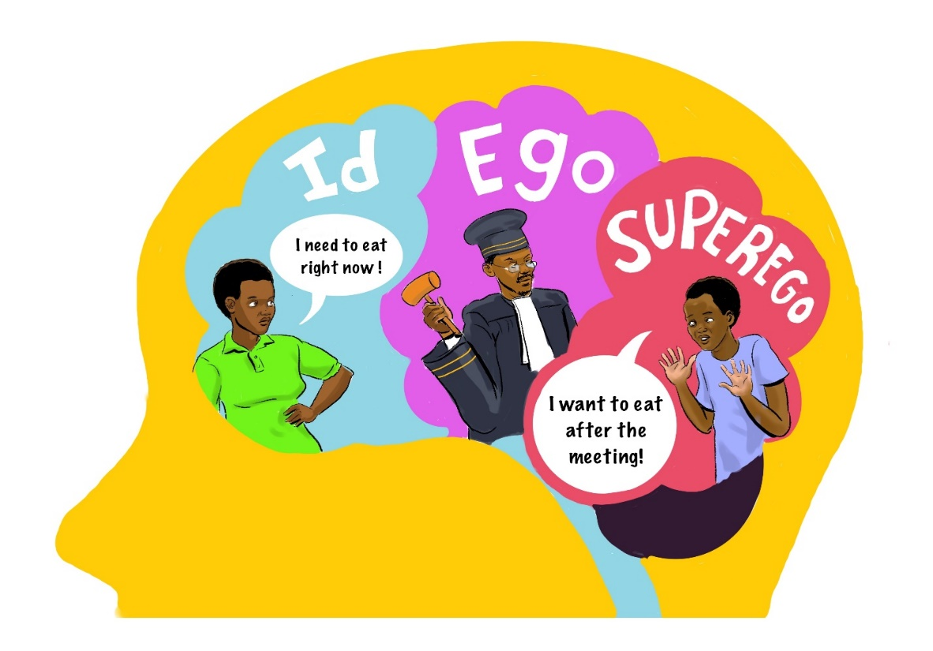
Theories of personality (Cont’d)
Psychoanalytical / psychodynamic theories
(a) Structure of personality by Sigmund Freud
There are three sub-systems or structures of personality:
id
ego
superego

Slide 86
Psychoanalytical / psychodynamic theories
Freud's Stages of Personality Development
Stage name | Approximate age | Erogenous zone (source of pleasure) | Main activity
Oral | Birth – 1 year | Mouth | Eating & drinking: chewing, biting, sucking
Anal | 1 – 3 years | Anus | Defecation
Phallic | 3 – 6 years | Genitals | Masturbation/Self Manipulation
Latency | 6 – puberty | Libido inactive | Socialization, intellectual activity
Genital | Puberty – death | Genitals: maturing sexual interests | Sexual intercourse

Slide 87
Psychoanalytical / psychodynamic theories
(b)Neo-analytic or Neo-Freudians:
Carl Rogers’ non-directivity for the congruence of individual.
A. Adler with his inferiority and superiority complexes.
C.G. Jung with collective unconsciousness.
H. Erikson with his psychosocial theory with the 8 stages of personality development

Slide 88
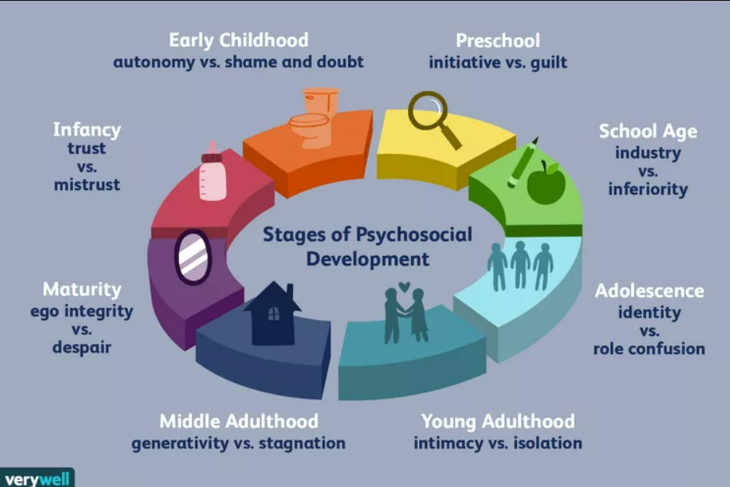
Psychoanalytical / psychodynamic theories
Psychosocial stages by E. Erikson

Slide 89
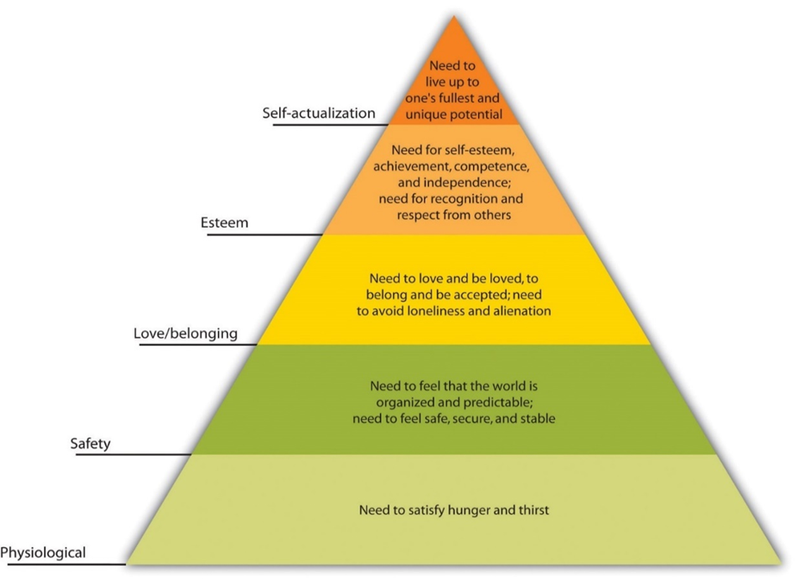
Humanistic theory
BY Carl Rogers and Abraham Maslow
self-determination, growth, and glory

Slide 90
Theories of personality (Cont’d)
Socio-cognitive theory
It is developed by Albert Bandura.
It considers personality as the result of observational learning.
emphasizes the role of cognitive processes, such as thinking and judging, in the development of personality.

Slide 91
Pedagogical implications of personality on teaching and learning
For the teacher to understand who the learners are, personality knowledge is essential.
The role of the teacher is to shape suitable learners’ personality.
Teachers should provide a holistic education to learners. This means that teachers shall address all aspects of human development (intellectual, emotional, social, physical, moral, etc.), addressing thus learners’ individual whole personality.
ADD….

Slide 92
Theories of personality (Cont’d)
Application activity 3.3 ( in pairs)
In pairs, with concrete examples, explain the personality traits of your learners according to:
Sigmund Freud
Erik Erikson
Abraham Maslow

Slide 93
Summary of the Unit
Meaning of Personality
Uniqueness and identity characterize personality
Heredity and environment determine personality
Three subsystems of personality (Sigmund Freud): Id, Ego, and Superego
Theories of personality:
Psychoanaltic
Humanistic
Socio-cognitive
It is impact to study personality for teaching and learning enhancement.

Slide 94
DAY 4

Slide 95
WELCOMING TEACHER TRAINEES AND RECAP OF DAY 3

Slide 96
UNIT 4: SOCIAL PSYCHOLOGY

Slide 97
SOCIAL PSYCHOLOGY
Activity 4.1 (Brainstorming)
Think about your day-to-day life and how many times you interact with others - family members, neighbors, roommates, classmates, team members, teachers, etc. - and explain what would happen without them.

Slide 98
Unit Learning Outcomes
Explain briefly the concepts related to social psychology.
Understand the causes and consequences of people’s actions.
Differentiate the types of groups.
Explain the management of classroom groups.
Apply the knowledge of social psychology in school context.

Slide 99
Unit Structure
Section 1: Key Concepts Related to Social Psychology
Section 2: Social Influence
Section 3: Social Perception
Section 4: Social roles and norms, obedience, and leadership
Section 5: Group dynamics
Section 6: Inter-group Conflicts and Inter-group Conflict Resolution
Section 7: Importance of Social Psychology in Teaching and Learning

Slide 100
Section 4.1: Key Concepts Related to Social Psychology
Activity 4.1 (Brainstorming)
You participated in at least one group while in primary or secondary school. How did each member influence the group? Did you have any members of the group who were influencing more than others? How was that influence? Were you happy with that influence?

Slide 101
Key Concepts Related to Social Psychology
Social psychology: It is a branch of psychology that studies individuals as they interact with others.
Social behavior: This term refers to the behavior shared by the society’s members because of the interactions within them. E.g., Shaking hands, hugging each other.
Social influence: is the process by which an individual's attitudes, beliefs or behavior are modified by the presence or action of others.

Slide 102
Key Concepts Related to Social Psychology
Persuasion: is a process by which a person influences another to change his attitudes by communicating him/her certain message(s). Persuasion depends on three factors: the communicator, the message, and the audience.
Peer pressure: is about changing personal attitudes and beliefs due to direct influence of peers.
Conformity: refers to the adjustment of one’s behavior to align with the norms of the group. It involves the acceptance of social and cultural goals and means of attaining those goals.

Slide 103
Key Concepts Related to Social Psychology
Social perception: refers to the process through which an individual seeks to know and understand other people.
Social loafing: refers to the tendency for people to spend less effort when in a group than alone.
Social facilitation: this concept refers to the fact that people tend to improve their performance on a task in the presence of others. For instance, the presence of football fans improves players’ performance.

Slide 104
Key Concepts Related to Social Psychology (cont’)
Groupthink:It is a phenomenon that occurs when a group of individuals reaches a consensus without critical reasoning or evaluation of the consequences or alternatives.
Superordinate goals: refer to the goals that get people from opposing sides to come together and work toward a common result.

Slide 105
Key Concepts Related to Social Psychology (cont’d)
Application Activity 4.1 (Brainstorming)
Look at the proposed strategies below. Identify the ones that can be used to mitigate (fighting against) social loafing in your class:
Set group goals, so the group has a common purpose to strive toward.
Increase intergroup competition, which again focuses on the shared outcome.
Engage in peer evaluation so each person evaluates each other person’s contribution.
Select members who have high motivation and prefer to work in groups.

Slide 106
Section 4.2: Social Influence
Activity 4.2 ( Think-Pair-Share)
In your class, explain how you influence learners to execute your decisions and how learners influence each other?

Slide 107
Social Influence (Cont’d)
Social Influence is realized in the following ways: Persuation and Conformity:
Persuasion: for example; parents may persuade their child to enroll to a certain school different from the child’s choice.

Slide 108
Social Influence (Cont’d)
Social influence is defined as efforts by one or more individuals to change the attitude, beliefs, perceptions, or behaviors of one or more others.
Social influence can be manifested through majority influence or minority influence.

Slide 109
Social Influence (Cont’d)
Majority influence
In majority influence or conformity, the larger group influences the individual or smaller group.
There are two explanations of why people conform: either they want to be accepted in a group (normative influence), or they want to do what is correct (informational influence).
Minority influence
In minority influence, the individual or smaller group influences the larger group and causes a change in the behaviour or thinking of the larger group

Slide 110
Social Influence (Cont’d)
Conformity: Many people show strong tendencies toward conformity; they obey social norms most of the time. Conformity is manifested through:
Compliance
Identification
Internalization

Slide 111
Social Influence (Cont’d)
Application activity ( group discussions & Presentations)
There are different ways social influence can happen. Select two ways that you see happening in your class and explain how they happen.

Slide 112
Section 4.3: Social Perception
Activity 4.3 ( Case study)
A young lady called Nyiramwiza is 20 years old. She is exceptionally very beautiful. She is in a supermarket, and all people turn to watch her. What impression is Nyiramwiza leaving on them?

Slide 113
Social Perception (Cont’d)
Social perception is the process through which an individual seeks to know and understand other people.
Social perception is well explained by:
Prejudice: Prejudice is an attitude that predisposes a person to think, perceive, feel and act in favorable or unfavorable ways towards a group or its individual members.

Slide 114
Social Perception (Cont’d)
Stereotypes: widespread generalizations about certain groups of people.
Discrimination: a differential (usually negative) behavior directed toward members of different social groups.

Slide 115
Social Perception (Cont’d)
Application Activity 4.2
Do the activity 4.2. According to the instructions. Page 74.

Slide 116
Section 4.4: Social roles and norms, obedience, and leadership
Activity 4.4 (Group discussions and presentation)
Kaneza arrives at the road junction. Traffic lights are on. Some vehicles one side have stopped and others on the other side are moving. Pedestrians on one side are standing but on the other side they are moving.
Suggest the title of the scenario.
Based on the scenario, what can happen if traffic road regulations are not followed?

Slide 117
Social roles and norms, obedience, and leadership (Cont’d)
Social roles: they are defined as a set of behaviors that individuals occupying specific positions within a group are expected to perform.
Social norms: Social norms refer to acceptable standards of behavior within a group that are shared by the group’s members.
Social obedience: Social obedience is a form of social influence in which one person simply orders one or more others to perform some actions.

Slide 118
Social roles and norms, obedience, and leadership (Cont’d)
Leadership: is the ability to influence, encourage and help others to work enthusiastically toward defined objectives.
Effective leaders do not command obedience; rather, they empower and energize followers

Slide 119
Social roles and norms, obedience, and leadership (Cont’d)
The styles of leadership:
Autocratic leadership
Democratic leadership
Laisser-faire leadership
Charismatic leadership
Transactional leadership

Slide 120
Social roles and norms, obedience, and leadership (Cont’d)
Application Activity 4.4 ( Individual presentation)
As a teacher trainee who has studied about social norms. Explain how you will enforce positive social norms in your class.

Slide 121
Section 4.5: Group dynamics
Activity 4.5 ( Group discussions and presentations)
In your school, learners tend to form different groups. Explain the basis on which those groups are formed.

Slide 122
Group dynamics (cont’d)
Social group is defined as two or more persons who meet for the following conditions:
(i) the relations among the members are independent
(ii) each member’s behavior influences the behavior of each of the others,
(iii) the members ‘share an ideology’

Slide 123
Group dynamics (cont’d)
Characteristics of a group
Relatedness to each other
Common interest
Feeling of belonging among the members of the group
Common values
Obligation
Expectations

Slide 124
Group dynamics (Cont’d)
Types of group and group boundaries
Groups are classified based on their size, structure, and affiliation.
Formal group;
Informal group;
Primary group;
Secondary groups;
In-group;
Out-group;
Reference groups;

Slide 125
Group dynamics (Cont’d)
Group Dynamics is described as positive and negative forces within groups of people
Group cohesion is when all members of a group support and validate one another at work
The technique of Sociometry is used to study group dynamics

Slide 126
Group dynamics (Cont’d)
Two types of the technique of sociometry: (Guess who technique& Nominating technique)
Guess who technique: The questions are asked to each pupil in the group. For example:
(a) With whom do you enjoy most in gathering?
(b) Who would you like to sit next to, in the class?

Slide 127
Group dynamics (Cont’d)
Nominating technique: The questions are asked to the pupils in the group. For example:
(a) Name the star of the Class.
(b) Name the group leader of your group.

Slide 128
Group dynamics (Cont’d)
Group work formation
Effective ways of forming group work
The role of the teacher in group work
Benefits of group work
Problems arising from group work
Group problem solving

Slide 129
Group dynamics (Cont’d)
Application 4.5 ( Individual presentation)
Referring to different types of groups and their characteristics, briefly explain how you can create effective groups in your class to improve pupils’ learning.

Slide 130
Section 4.6: Inter-group conflicts and inter-group conflict resolution
Activity 4.6 (Think –Pair-Share)
In your school, learners tend to form different groups. Explain the basis on which those groups are formed.

Slide 131
Inter-group conflicts and inter-group conflict resolution ( Con’t)
What is conflict?
Conflict is defined as a process in which individuals or groups perceive that others have taken or will soon take actions incompatible with their own interests.
Conflict can range from a simple disagreement to a war.

Slide 132
Inter-group conflicts and inter-group conflict resolution ( Con’t)
Social factors which playing a big role in initiating conflict:
Faulty communication
Faulty attribution
Tendency to perceive our own views as objective and as reflecting reality more than others

Slide 133
Inter-group conflicts and inter-group conflict resolution ( Cont’d)
Conflict management styles
The following are suggested useful ways in solving conflicts:
Avoidance
Accommodation
Collaboration
Compromise

Slide 134
Inter-group conflicts and inter-group conflict resolution (Cont’d)
Application Activity 4.6 ( Think-Pair-Share)
Assuming that you are a teacher of sport, and you have two strong teams which are fighting for one playground. The conflict has escalated to the extent that team members of one group do not want to greet team members of the other group. What best method can you apply to solve this situation?

Slide 135
Section 4.7: Importance of Social Psychology in Teaching and Learning
Activity 4.7 (Think-Pair-Share)
As a teacher, what do you see as the importance of Social Psychology in your teaching/learning?

Slide 136
Importance of Social Psychology in Teaching and Learning (Cont’d)
The following are some of the importance of Social Psychology :
It helps teachers and students to develop the ability to accurately read others’ thoughts, feelings, and motivation.
These principles do provide powerful tools to improve teachers’ pedagogy, bolster student motivation, and enrich students’ understanding of multiple content areas.
Social Psychology helps teachers to have the tools to understand the social dynamics of their classrooms.

Slide 137
Importance of Social Psychology in Teaching and Learning (Cont’d)
Application activity 4.7 (Brainstorming)
How can you apply the knowledge acquired in Social Psychology to improve your teaching career?

Slide 138
Unit Summary
The key concepts related to Social Psychology.
How social influence is done.
The social perception and its effect on the group members or the society in general.
Group dynamic.
Inter-group conflicts and how the conflict resolution is done.
The importance of Social Psychology in teaching and learning.

Slide 139
DAY 5

Slide 140
Welcoming teacher trainees and Recap of day 4
Social psychology:
Concepts related to social psychology
Social influence
Social perception
Social roles and norms, obedience, and leadership
Group dynamics

Slide 141
UNIT 5: LEARNING THEORIES AND THEIR APPLICATIONS TO THE TEACHING AND LEARNING PROCESS

Slide 142
LEARNING THEORIES AND THEIR APPLICATIONS TO THE TEACHING AND LEARNING PROCESS
Introductory activity, page 90. (Voting technique)
Do the following activity following the instructions. Refer to the module page 90

Slide 143
Unit 5: Learning outcomes
Unit learning outcomes:
Demonstrate an understanding of the fundamental theories of teaching and learning.
Explain the relationship between theories of learning and teaching.
Apply key learning and teaching theories in the classroom setting.
Explain and analyse factors that influence learning

Slide 144
Unit structure
These theories are:
Behaviorism
Cognitivism
Constructivism
Social Learning
Social Cultural
Socio-emotional
Factors that Influence Learning

Slide 145
Section 5.1: Behaviorism Theory of Learning
Activity 5.1 (Voting technique)
Work on the activity 5.1. It is on page 92

Slide 146
Behaviorism Theory of Learning ( Con’t)
To be covered:
What is behaviorism?
Types of behaviorism theories:
Classical conditioning
Operant conditioning
Tips for applying behaviorism in the classroom

Slide 147
Behaviorism Theory of Learning ( Con’t)
What is behaviorism?
Stimuli
Response

Slide 148
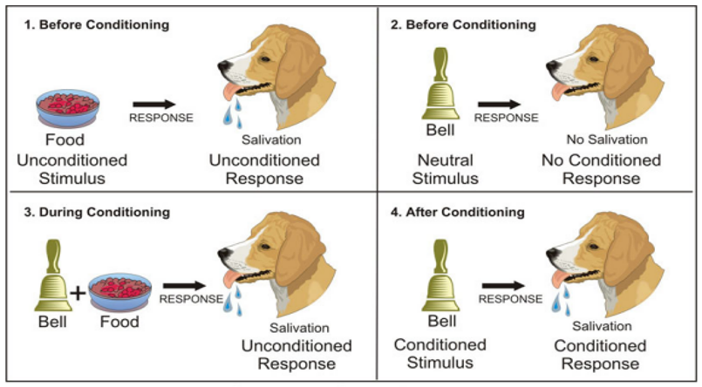
Behaviorism Theory of Learning ( Con’t): Classical conditioning

Slide 149
Behaviorism Theory of Learning
Terms used in classical conditioning
Unconditioned stimulus (US)
Unconditioned response (UR) : Some examples of the US-UR pairs include:
Sneezing (UR) to pepper (US)
Shivering (UR) to cold (US)
Blinking (UR) to a bright light (US)
Neutral stimulus (NS)
Conditioned stimulus (CS)
Conditioned Response (CR)

Slide 150
Classical conditioning ( Con’t)
Laws of classical conditioning
Stimulus generalisation
Stimulus discrimination
Extinction
Spontaneous Recovery
Higher Order Conditioning

Slide 151
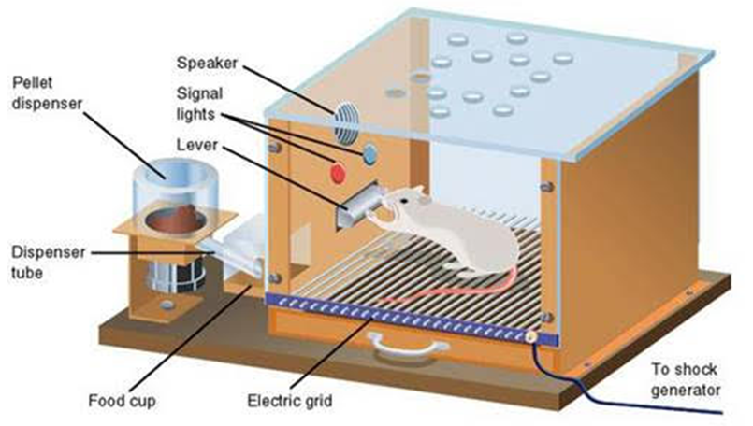
Operant conditioning

Slide 152
Operant conditioning ( con’t)
Meaning of operant conditioning
It is also known as instrumental conditioning,
It uses rewards and punishment to modify behaviour.
Actions are influenced by their results.

Slide 153
Operant conditioning ( con’t)
Role of reinforcement and punishment in operant conditioning
Reinforcement :
Positive reinforcement means adding a stimulus.
Negative reinforcement
Punishment:
Positive punishment
Negative punishment

Slide 154
Operant conditioning ( con’t)
Laws of operant conditioning
The law of effect
Law of exercise“law of use and disuse”.
The law of readiness
The law of similarity of stimuli
The law of contiguity/ immediacy
The law of spacing

Slide 155
Operant conditioning ( con’t)
Tips for applying behaviourism in the classroom
Make students active; give them chance to practice and show what they know.
Build positive associations with learning tasks.
Give students frequent and repeated practice, in varied contexts.
Break tasks into achievable steps and provide positive reinforcement for achieving each step.
ADD…

Slide 156
Behaviorism Theory of Learning ( Con’t)
Application activity 5.1( Brainstorming)
With the examples how you will apply theory of classical and operant conditioning theories in your class?

Slide 157
Section 5.2: Cognitivism Learning theory
Activity 5.2. This is about Teacher Rwema ( group discussions &Presentation)

Slide 158
Cognitivism Learning theory ( Con’t)
To be covered:
A brief description
Use of cognitivism theory in teaching and learning
Tips to help your learners process the information being taught
Characteristics of a classroom instruction based on cognitive theories

Slide 159
Cognitivism Learning theory ( Con’t)
A brief description
According to cognitivists, mental processes and past knowledge influence behavior or response more than external stimuli do (Deubel, 2003), and they stand between an external stimulus and an internal response (Winn & Snyder, 1996).
The focus is on using information processing to make knowledge meaningful. When new information is related to what you already know, learning takes on a more significant meaning.

Slide 160
Cognitivism Learning theory ( Con’t)
Use of cognitivism theory in teaching and learning
Students attend school to learn and pick up skills, knowledge, attitudes, and values.
Students take in and digest the knowledge that teachers impart to them in their memories.
As a result, one of the responsibilities of a teacher is to aid students in the information processing necessary to grow cognitively.

Slide 161
Cognitivism Learning theory ( Con’t)
Tips to help your learners process the information being taught
Provide organised instruction
Use single, coherent representations so that the learner can be focused.
Link new material with what is currently known.
Make sure that the learner will not attend to too many different elements at the same time.
Allow learners to identify the most important points to be learned.
Eliminate redundancy.

Slide 162
Cognitivism Learning theory ( Con’t)
Application Activity 5.2 (Individual Presentation)
Take a topic in 1 subject you teach and explain how you will apply cognitive learning theory to teach that topic.

Slide 163
Section 5.3. Constructivism learning theory
Activity 5.3, (case study)page 104

Slide 164

Constructivism learning theory (Con’t)
Meaning of constructivism

Slide 165
Constructivism learning theory (Con’t)
Educational implications
Seek and value your learners’ points of view.
Pose problems and structure classroom experiences that foster the creation of personal meaning.
Not provide everything, but rather incite learners to build knowledge.
ADD…

Slide 166
Constructivism learning theory (Con’t)
Application activity 5.3( Case study)
Go back to the scenario provided in activity 5.3 and highlight where the teacher is applying constructivism theory.

Slide 167
Section 5.4: Social Learning theories
Activity 5.4 (Brainstorming)
1. Make a brief comment about this Rwandan proverb “Kora ndebe iruta vuga numve”. How can you apply this proverb in the learning process?
2. What do you think will happen if a learner observes his/her classmate being rewarded for his/her good performance?

Slide 168
Social Learning theories (Con’t)
Meaning
Children learn by observing, modeling, and imitating others' behavior.
Albert BANDURA argues that people pick up new skills by watching role models and copying what they do.

Slide 169
Social Learning theories (Con’t)
Elements of observational learning
Attention
Retention
Reproduction
Motivation

Slide 170
Social Learning theories (Con’t)
Principles of social learning
Direct reinforcement
Vicarious learning
Modelling

Slide 171
Social Learning theories (Con’t)
Implication of social learning in education
A teacher should manifest exemplary behaviours.
A teacher should show interest and enthusiasm in the content
A teacher must identify the specific social and effective students’ learning outcomes.

Slide 172
Social Learning theories (Con’t)
Application activity 5.4 (Group discussions & Presentation)
Discuss how the principles of social learning can be applied in teaching and learning process

Slide 173
Section 5.5.Social Cultural learning theory
Activity 5.5 Scenario. (Group Discussion, Presentation) page 107

Slide 174
Social Cultural learning theory ( Con’t)
Meaning of sociocultural theory
It is originated from Lev Vygotsky.
It supports the influence of society in the cognitive development of the children.
We learn through interactions

Slide 175
Social Cultural learning theory ( Con’t)
Principles of Vygotsky’s Theory
MKO (More Knowledgeable Others)
ZAD (Zone of Actual Development)
ZPD (Zone of Proximal Development)
Scaffolding

Slide 176
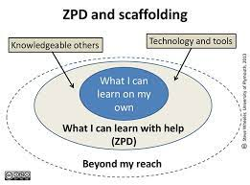
Social Cultural learning theory ( Con’t)

Slide 177
Social Cultural learning theory ( Con’t)
Educational implications
The teacher plays the role of a mentor
Use of ZPD
Use more-skilled peers

Slide 178
Social Cultural learning theory ( Con’t)
Application activity 5.5 (Think-Pair-share, Presentation)
Discuss how you can apply social-cultural learning theory in your class.

Slide 179
Section 5.6.Socio-emotional learning theory
Do the activity 5.6, (Group discussion, Presentation).

Slide 180
Socio-emotional learning theory( Con’t)
Social-emotional learning is the way in which we manage and understand our emotions .
Setting positive goals and making good decisions are a keystone in teaching social-emotional learning skills on:
How to solve problems and overcome challenges.
How to manage their emotions when they are not getting their way.
How to treat others.
How to control impulses.

Slide 181
Socio-emotional learning theory( Con’t)
The theory of social-emotional learning is from ancient times with the work of Plato.
He stressed that by maintaining a sound system of education and upbringing, you produce citizens of good character.
How child’s experiences both at home and school deeply affect his/her psychosocial development and this in turn shapes the academic achievement.

Slide 182
Socio-emotional learning theory( Con’t)
Application Activity 5.6 (Brainstorming)
In your daily teaching, how do you shape the social emotional development of your learners?

Slide 183
Section 5.7.Factors that Influence Learning theory
Activity 5.7 (Group Discussion, Presentation)
In small group, work on activity 5.7

Slide 184
Factors that Influence Learning theory ( con’t)
Factors related to the learners
Physiological factors
Health:
Sex/ gender:
Age: Young individuals learn better and more easily than the old ones.

Slide 185
Factors related to the learners ( Con’t)
Psychological factors that influence learning:
Motivation,
will, interest,
memory,

Slide 186
Factors related to learners( Con’t)
Learning styles:
Visual learners
Auditory learners
Tactile learners (kinesthetic)
Multimodal learners.

Slide 187
Factors that Influence Learning theory (Con’t)
Factors related to the teacher
the teacher’s personality and
qualifications.
Factors related to the learning environment
Family related factors
Parents’ level of education
The school environment

Slide 188
Factors that Influence Learning theory (Con’t)
Application Activity 5.7 (Individual Presentation)
Taking your school as an example, how does knowledge of factors related to school environment help you to improve the students’ learning?
There are some factors related to you as a teacher that may negatively impact students’ learning. What are those factors and what do you do to minimise them?

Slide 189
SUMMARY OF THE UNIT 5
Behaviorism theory of learning and its implications
Cognitivism theory of learning
Constructivism theory of learning and its educational implications
Social learning theories and their implication of social learning in education
Social cultural theory and its educational implications
Socio-emotional learning
factors that influence learning

Slide 190
DAY 6

Slide 191
Welcoming teacher trainees and Recap of day 5
Behaviorism learning theory and its implications
Cognitivism learning theory
Constructivism learning theory and its educational implications
Social learning theories and their implication in education
Social cultural learning theory and its educational implications
Socio-emotional learning
Factors that influence learning

Slide 192
UNIT 6: GUIDANCE AND COUNSELLING

Slide 193
GUIDANCE AND COUNSELLING
Introductory activity 6 ( Group discussions and presentation)
In everyday activities at school, you meet different life challenges and problems related to social, moral, and personal development of the learners both inside and outside the school environment.
Think about the above statement and answer the following questions:
a) How do you support learners with social, moral and personal problems or challenges?
b) How confident are you to solve those problems when you faced with such a situation?

Slide 194
Guidance and counselling (Con’t)
Learning outcomes:
To identify the qualities, characteristics of effective guidance and counselling
To enable teachers to diagnose students’ learning difficulties and offer appropriate solutions
To apply guidance and counselling skills in schools
To respect ethical considerations when guiding and counselling students in their respective schools

Slide 195
Guidance and counselling ( Con’t)
Structure of the unit:
Key Concepts Related to Guidance and Counselling
Types of Guidance and Counselling
Principles of Guidance and Counselling
Major Counselling Skills
The process of guidance and counseling
Teacher as a Counsellor
Special Considerations of Guidance in Early Childhood Education

Slide 196
Section 6.1:Key Concepts Related to Guidance and Counselling
Activity 6.1, (Individual presentation) page 117-118

Slide 197
Key Concepts Related to Guidance and Counselling (Con’t)
Guidance
Counselling
Difference between guidance and counselling ( page 119)

Slide 198
Key Concepts Related to Guidance and Counselling (Con’t)
Application activity 6.1(Brainstorming)
1. Now you have understood the concepts of guidance and counselling, in what situations do you apply them in your class?
2. Provide an example of what you did that should be qualified as guidance or counselling at your school? Justify the reason why it is qualified as guidance or counselling.

Slide 199
Section 6.2:Types of Guidance and Counselling
Activity 6.2 (group discussions& Presentation), page 120-121

Slide 200
Types of Guidance and Counselling ( Con’t)
Guidance and counselling types are:
Educational/Academic
Vocational/Career
Personal/Social

Slide 201
Types of Guidance and Counselling ( Con’t)
Educational/Academic guidance and counselling
The guidance which a learner needs.
Educational/academic guidance and counselling is vitally related to every aspect of the educational institution or of the school’s aims and objectives, the curriculum, the methods of teaching, discipline, role of the teacher and the co-curricular activities.
There are four different stages of educational or academic guidance and counselling for every level of education, but this module focuses on:
Pre-primary and
primary education.

Slide 202
Types of Guidance and Counselling ( Con’t)
Educational or academic guidance and counselling at the Pre-Primary stage:
At this stage, the guidance and counselling must help the child know to adjust himself to the new school life.
The teacher performs the functions of both the teacher and the counsellor.
He/she can very easily discover the children who are dependent, shy, easily frightened, over aggressive, quarrelsome, gifted or otherwise, etc.

Slide 203
Types of Guidance and Counselling ( Con’t)
Educational/academic guidance and counselling at primary stage:
At this stage, the child must be helped to:
Develop his power of thinking and understanding,
Know modes of living and thinking which will become the main ground of his/her habits and attitudes,
Adjust him/herself to an expanding environment both within the school and outside,
Explore his/her talents and understand him/herself,
Make a good beginning and intelligently plan their education,
Prepare pupils how to enter secondary school,

Slide 204
Types of Guidance and Counselling ( Con’t)
Vocational/Career guidance and counselling
The assistance given to children or students in schools to know the world of vocations in their life.
It is concerned with helping the individual to:
Become aware of his/her strengths and weaknesses in the world of occupations
helping him/her to choose a vocation for his better adjustment with every situation of the society.

Slide 205
Types of Guidance and Counselling ( Con’t)
Personal/Social guidance and counselling
The process of helping an individual to know how to behave in relation to other people.
It is about the assistance given to the individual to solve his emotional, social, ethical, and moral as well as health problems.
In the school setting, personal counselling is often suggested for children who display behaviour problems, such as:
excessive fighting,
chronic tiredness,
violent outbursts,
extreme withdrawal, ….

Slide 206
Types of Guidance and Counselling ( Con’t)
Application Activity 6.2 (Pair)
When and how would you apply academic, personal and career guidance to your learners?

Slide 207
Section 6.3:Principles of Guidance and Counselling
Activity 6.3 (Reflective method &Debate)
Assess the following statement and say whether it is correct or not. “Guidance and counselling are not for all persons; they are for people with special problems only; young people do not need such kinds of services”.

Slide 208
Principles of Guidance and Counselling(Con’t)
It is for everyone.
It must be provided in a way that ensures human dignity and worth.
It is a sequential, continuous, and developmental process, which starts from birth to death.
It aims at the holistic development of an individual
ADD… Page …

Slide 209
Principles of Guidance and Counselling( con’t)
Application Activity 6.3( Individual presentation)
Write down 3 basic principles of Guidance & Counselling that you mainly apply in your classroom and clearly explain how.

Slide 210
Section 6.4.Major Counselling Skills
Activity 6.4 (Think-Pair-Share)
What do you do to advise learners about their academic and personal issues?

Slide 211
Major Counselling Skills ( Con’t)
Active listening
Listening can be used in many ways:
Attending
Nonverbal listening
Verbal listening

Slide 212
Major Counselling Skills ( Con’t)
Some tips for effective listening:
Stay present
Make eye contact
Ask questions for clarification
Acknowledge feelings
Restate or paraphrase
Covey says, Seek first to understand and then to be understood,…

Slide 213
Major Counselling Skills ( Con’t)
The other counselling skills
Empathy
Confidentiality
Reflecting
Paraphrasing
Clarifying and the use of open questions

Slide 214
Major Counselling Skills ( Con’t)
Application activity 6.4 (Role play)
Work on the above activity according to the instructions

Slide 215
Section 6.5:The process of guidance and counseling
Activity 6.5 (Group discussions and Presentation)
You have attended your school for at least a year. Every day, you must instruct and advise students. Describe what you do to keep your relationship with them positive.

Slide 216
The process of guidance and counseling (Con’t)
Those steps are:
Relationship building
Problem assessment
Goal setting
Intervention
Evaluation, follow-up, termination, or referral

Slide 217
The process of guidance and counseling (Con’t)
Application activity 6.5( Role play)
Now that you have studied steps in counselling process, imagine a counselling session about a student in need of counselling. Organize a role play by respecting the five steps.

Slide 218
Section 6.6:Teacher as a Counsellor
Activity 6.6 ( Question-Answers)
Have you ever experienced a situation that requires teachers at your school to practice guidance and counselling? If yes, describe that situation and give reasons why it required guidance and counselling skills.

Slide 219
Teacher as a Counsellor ( con’t)
Qualities of a counsellor
Guidance services provided by a teacher
Techniques used in guidance and counselling
Ethical considerations in guidance and counselling

Slide 220
Teacher as a Counsellor ( con’t)
Qualities of a counsellor
The top traits that every school counsellor should have:
Be a good listener,
Able to assess their students in terms of guidance and counselling,
Excellent communicator,
Appreciate diversity,
Friendly, ….

Slide 221
Teacher as a Counsellor ( con’t)
Guidance services provided by a teacher:
Individual Inventory Service
Orientation Service
Information Service
Counselling Service
Placement Service
Referral Service,…..

Slide 222
Teacher as a Counsellor ( con’t)
Techniques used in guidance and counselling
Observation
Interview
Cumulative record:
Personal
Home
Test scores
School attendance
Health:
Miscellaneous

Slide 223
Teacher as a Counsellor ( con’t)
Questionnaire
Case study

Slide 224
Teacher as a Counsellor ( con’t)
Ethical considerations in guidance and counselling
Confidentiality
Relationships:
Objectivity
Voluntary participation
Professionalism

Slide 225
Teacher as a Counsellor ( con’t)
Application Activity 6.6( Group Discussions and Presentation)
Design a questionnaire that will help you to collect maximum information that will be used in guidance and counselling of a learner with disruptive behaviour at your school.

Slide 226
Section 6.7.Special Considerations of Guidance in Early Childhood Education
Activity 6.7( Group discussions and Presentation)
Now that you have studied guidance and counselling in primary schools, do you think that it can apply to children in Early Childhood Education? Explain.

Slide 227
Special Considerations of Guidance in Early Childhood Education
Purposes of guidance and counselling for young children
Help young children analyse their weaknesses and then overcome them.
Help young children make wise decisions.
Assist especially young students, who are undergoing counselling and guidance sessions.

Slide 228
Special Considerations of Guidance in Early Childhood Education ( Con’t)
Important roles of teachers in guidance and counselling in
Early Childhood Education
Parenting the child while in school
Guiding the child on appropriate conduct
Assisting and comforting the child
Identifying and assisting children with difficulties

Slide 229
Special Considerations of Guidance in Early Childhood Education ( Con’t)
Areas of counselling and guidance services in Early Childhood
Education
mainly areas of concern:
Vulnerability within the school environment:
Learning disabilities
Communication:
Introversion:
Stress and anxiety,……..

Slide 230
Special Considerations of Guidance in Early Childhood Education ( Con’t)
Application activity 6.7( Question –Answer)
Assume you are a teacher in a nursery school and at the beginning of the academic year you receive children to teach. Elaborate a plan of all activities you will do to make them comfortable

Slide 231
Summary of unit 6
The concepts of guidance and counselling.
Types of guidance and counselling: Educational/Academic guidance, Personal/Social guidance, and Vocational guidance.
Major counselling skills including active listening skills that require attending, non-verbal listening, and verbal listening.
Qualities of a counsellor, techniques of guidance and counselling, ethical considerations in guidance and counselling, special considerations in guidance and counselling.

Slide 232
Summary of the module
Introduction to Educational Psychology,
Human Developmental Psychology,
Personality,
Social Psychology,
Learning Theories and their applications to the teaching and learning process,
Guidance and Counselling.

Slide 233
POST-TEST

Slide 234
THANK YOU

